Slide 1
Cluster Development
TOOLKIT
PHASE II - MOBILIZATION
Saskatchewan Economic Development Alliance

Slide 2
Phase II Mobilization
Building on the information gathered in Phase 1, the developer will be prepared to focus on the following steps:
Resource Mobilization. Identify roles and contributions of support institutions and public sector agencies.
Problem Mitigation. Developers can identify and discuss potential mitigation of industry challenges identified in Phase I.
Collaboration Rationale. As part of a cluster muster or individual discussions with stakeholders, identify the benefits and expectations of working collectively. Illustrate potential value impact.
First Steps to Strategy. Begin to articulate basic strategy around identified opportunities. An in-depth strategic plan and business model will be developed in Phase III, should the group move forward.
Cluster Muster. Host a meeting of industry and associated support institutions to talk about the projected impact of working together.
Cluster Intervention
One size does not fit all–interventions must reflect local strengths, assets, and opportunities. Cluster developers can play a supporting role, but cluster initiatives must involve local actors.

Slide 3
1. Resource Mobilization
Arranging resources for carrying out activities.
Manpower, knowledge and financial contributions by firms involved AND knowledge of firms not involved.
Knowledge and financial contributions by technical institutions.
Financial (loan or grant or technical expertise) contribution by funding institutions.
Financial, knowledge and manpower contribution by associations/networks.
Resources mobilized from among the cluster actors.

Slide 4
Mapping Resource Mobilization Capacity
Identifying and mapping projected capacity will assist in preliminary cluster strategy development and determination of value impact.
ACTIVITY | MANPOWER |  |  |  |  | KNOWLEDGE |  |  |  |  | FINANCE
 | TI | FI | AN | NW | F | TI | FI | AN | NW | F | TI | FI | AN | NW | F
WORKSHOP
TRAINING
MARKETING
FINANCE
QUALITY
TECHNOLOGY
INFRASTRUCTURE
ENVIRONMENT
COORDINATION
TI = Technical Institution
FI = Finance Institution
AN = Association
NW = Network
F = Firms
EASY
POSSIBLE
DIFFICULT
Source: UNIDO

Slide 5
2. Discuss Problem Mitigation
Generally Accepted Principles
Solutions for some problems are available in the cluster. Why problems have not been solved is because they have never been consolidated (e.g. economies of scale problems)
A large number of problems have been solved elsewhere – places which are approachable, but most of the entrepreneurs are not aware of them. Exposure is the answer. (e.g. better technology in other processing clusters)
Some problems are such that they need a prolonged brainstorming amongst the entrepreneurs – solutions emerge as they get deeper and deeper into issues.
Some solutions and problems are unknown to each other. Matchmaking /networking is required. (e.g. linkage with existing but unknown service providers)
Some solutions are known – but there is a risk in trying those solutions out. Sharing the risk is the answer. (e.g. trade delegation to another country)

Slide 6
LACK OF MARKETING LINKAGES
Joint participation in dealing with local traders/municipal markets players Joint participation in exploring international business opportunities Training in marketing Exposure to marketing outlets/markets Diversification in products/selection of product mix through common expert (service provider) Creation of a common brand Buyer Seller meet Common web site Common advertisement Joint exploration of new international markets
POOR PRODUCT QUALITY
Joint hiring of consultant for quality improvement Common testing laboratory Common training for workers on quality issues Common access to Quality Certifications
POOR TECHNOLOGY
Exposure to right technology Joint negotiation for buying machinery Arranging technology exhibition for technology sellers
Problem Mitigation
Examples

Slide 7
CREDIT AVAILABILITY
Setting up mutual credit guarantee (MCG) schemes Sensitization of bankers Suggesting new financial products through experts and experiences from other countries Customers give order security to banks
HIGH COST OF PRODUCTION
Joint procurement of raw/input material Common consultant for re-designing or improving the production process Common consultant on cost auditing
LOW PRODUCT DIVERSIFICATION
Hiring a common consultant to introduce the right product mix Exposure to other benchmark enterprises/networks/clusters Networking with potential new customers
POOR SOCIAL CAPITAL
Strengthening existing association Forming new associations Forming small groups – consortia
Problem Mitigation
Examples

Slide 8
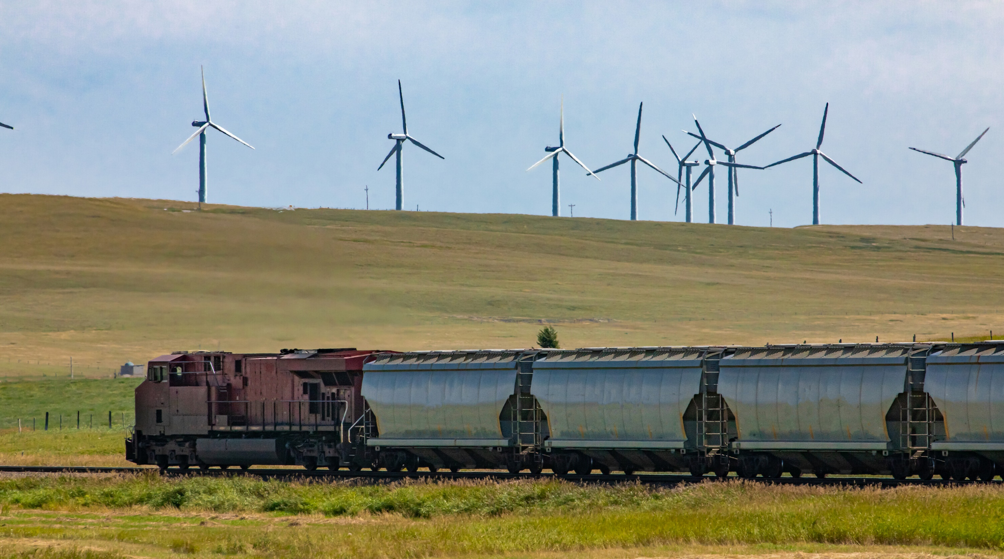
POOR SKILLS
Common training Starting a new training programme with a training institute and institutionalizing it Introducing a common service provider for hands-on training for production of a particular product
POOR INFRASTRUCTURE
Establish joint facilities / infrastructure Common facility centers for use of capital-intensive tools (tractors, tillers), providing transportation, packaging, processing plants, etc. Executing projects through Public Private Partnership (PPP) mode
LACK OF INNOVATION
Promotion of direct intervention between producer and consumer/customer Networking with a local technical institute for innovation related inputs Removing isolation of the cluster as a whole (e.g. people traveling outside, external customers approaching the cluster, sharpening competition amongst groups etc)
Problem Mitigation
Examples

Slide 9
3.a Collaboration Rationale
Sourced from Strategy Tools, this resource helps you identify what members of a cluster would want out of it. This helps you map out the fundamental tasks a cluster needs to focus on in order to succeed.
RANK#_______
RANK#_______
RANK#_______
RANK#_______
RANK#_______
Market Opportunities
Customers
Collaboration
Talent Development
Capital
What kind of market opportunities do you expect from being in a _____cluster?
Should we be looking outside the province and country?
How can a ____cluster, help your organization gain more customers?
Develop new cross industry collaboration projects.
Develop new talent and skills that will benefit the industry. This could range from student interns to short specialized programs to post-grad programs.
Develop a robust capital market from early-stage seed and angel funding to scale up and growth.
Source: Strategy Tools

Slide 10
3.a continued
This resource could be used during early group meetings as you begin to ‘muster the cluster’.
RANK#_______
RANK#_______
RANK#_______
RANK#_______
RANK#_______
New Partnerships
Access to new technologies & business models
Faster innovation within your firm
Access to startups
Building new startups
What kinds of partnerships do you expect from being in a _____cluster?
How would your company like to work with and gain access to new high impact ____startups?
What can new ____startups bring to you?
We need more high-quality startups and scale ups. How can the cluster help launch new ventures?
True transformation requires faster innovation. This can be done through corporate bootcamps, innovation labs or large-scale transformation programs. What kinds of programs would be most important to you?
How can a ____cluster, help you gain access to emerging technologies & business models?
Source: Strategy Tools

Slide 11
3.a continued
RANK#_______
RANK#_______
RANK#_______
Access to learning, best practices, building innovation strategies
Navigating industry shifts
Anything else?
The cluster should help us navigate significant industry level change, reaching beyond the capabilities of any one cluster member.
What would you want from a ____cluster?
Learning from others can be powerful. Case studies, workshops and study trips – how could these assist you? Is there relevancy to your organization?
Source: Strategy Tools

Slide 12
Cluster Value Triangle
3.b Illustrating Value Impact
Value and performance measurement will be formalized in Phase III, Implementation. However, cluster developers will benefit from illustrating the potential aggregated value impact as part of an early stage ‘cluster muster”.
What is the cluster’s ambition? What could we achieve and create together?
What are some potential strategies for getting us there?
What are possible strategic focus areas and strategic initiatives for the cluster?
Ambition
& Strategy
The Cluster Value Triangle is a strategy framework that allows us to bring the key elements of strategy, structure and business model together in one integrated framework.
Job creation
Number of businesses & organizations engaged
Contributions to economy & region
How could the cluster be structured? Potential governance model?
What would a potential board of directors look like(size, composition)
Does the creation of working or Iinnovation groups to guide strategy implementation resonate?
How could the cluster be financed?
What types of public funding, private funding and project funding are a realistic target?
What might our base costs be and how do we grow while maintaining a highly flexible cost base?
How do we clarify our value impact and how do we design a winning cluster business model?
Structure & Governance
Business Model & Financing
Source: Cluster Business Models Report

Slide 13
4. First Steps to Strategy
Strategic planning and solidifying a cluster business model will be undertaken in Phase III.
The idea in Phase II is to find a few critical areas in the cluster for the cluster developer to illustrate that maximum change could occur if the stakeholders leverage their joint strengths.
Examples are:
Technology
Marketing linkages
Product diversification/selection of a product mix
Reduction in costs
Credit
Encourage Vigilance to Industry Shifts
These are deep, structural changes to an industry, industry norms or how an industry operates. Often, these take place over 10+ years before they fully materialize. They may not be taken seriously by industry leaders and experts e.g. “not how things are done in our industry”.
Industry shifts frequently represent significant disruption to existing businesses and they are generally only really understood in retrospect. Examples include the internet in the media industry; clean energy and electric cars in oil & gas industry.
Future-thinking, innovative firms can identify weak signals, invest to learn and develop new business models on major industry shifts. They must be prepared to “ride the waves of change”

Slide 14
For strategy purposes, most clusters would fall under one of these three categories:
UNDER-SELLING Clusters - clusters where capacity utilization is less than optimal e.g. clusters operating at 40-50% of capacity
STRATEGY: Enhance the capacity utilization by removing possible bottlenecks:
Quality is poor and hence market does not accept enough product
Price is high and hence sales are poor
Lack of designs
Product is good; price is okay, but entrepreneurs do not know where to sell
LOW PROFITABILITY Clusters - clusters where capacity utilization is full but operating margins are poor
STRATEGY: Enhance the margins, which could be done by removing possible bottlenecks:
Poor product quality
High cost of production
Poor perception about the product in buyer’s eyes
Right product in wrong market
UNSUSTAINABLE Clusters, which operate at full capacity and offer decent margins to producers, but do not operate in niche markets (competition is still cost-based....)
The main reason is lack of innovation in the cluster
STRATEGY

Slide 15
Mapping Industry Shifts
Internal
Very Strong
STRONG & STABLE
Shifts in «Strong & Stable» indicates the cluster has a strong position in an area with low outside change. This is an enviable position to have.
FUTURE FIT
Changes on the horizon are evident; and the cluster is already ahead of them. Weak signals are feeding strategy. A portfolio of emerging business models is in place
TROUBLE
The cluster is in dire trouble! You see the changes coming, but are slow, unsure or unable to deal with them. Transformational thinking required.
SLOW CHANGE
Low power of change, low ability or interest to change; this is a slow moving and steady environment. History tells us: dangers ahead!
Future-thinking, innovative firms can identify weak signals, invest to learn and develop new business models on major industry shifts.
STEP 1
List the top 3-4 industry shifts your industry is facing or expects to face in the future.
………………………………………………
……………………………………………...
……………………………………………...
……………………………………………...
……………………………………………...
Internal
Very Strong
Weak
STEP 2
Elect, sort and prioritize. Map projected industry shifts.
Internal = your ability to listen to weak signals, learn and take strong positions for future industry shifts.
External = the power of industry shifts you are facing
Source: Cluster Business Models Report
Weak

Slide 16
Business Model Canvas
This tool may assist cluster facilitators in the early stages of mobilization, guiding discussion of a collective value proposition for emerging clusters. It can also assist in revisiting the business model of existing clusters. The Business Model Canvas helps to visualize what is important and focuses attention that is required to address key areas.
The Business Model Canvas has nine different areas of focus that make up building blocks in a visual representation of the cluster:
Key Stakeholders & Partners: Who are the buyers and suppliers required to make the cluster a success What other alliances will fulfill the value proposition? Identify the sub-clusters that may be in place and/or the overall ecosystem.
Key Activities—What are the activities/programs offered to fulfill the value proposition?
Key Resources—What resources are needed to create value for the cluster members?
Value Proposition—What is the overriding ambition and vision of the cluster.
Member Relationships—What types of relationships will be/are currently forged with cluster members? What are the relationship expectations of members?
Members- includes current members; potential members and funding partners
Channels—Through what means will the cluster deliver programming?
Cost Structure—What are the key costs to operate/maintain the cluster? Which resources will cost the most? Which activities will cost the most?
Revenue Streams—Identify public, private and project revenue sources. How much will each revenue stream contribute to overall revenue?
Refer to the next slide for an example of a Cluster Business Model Canvas.

Slide 17
What are the transactional relationships?
85 sector members from private and supporting institutions
100 identified thus far
Digitization of member operations
Market development
Workforce attraction
Skills development
Example: Canada’s largest renewable energy cluster
“Helping our members play a transformative role in the shifting energy arena”
Identified 25 firms in relevant sectors
Bio-mass cluster
Bio-degradable flax manufacturing cluster
Electric charging station manufacturing
Innovation Group
Staff
Board of Directors
Industry Mentors
This could be adapted to media channels such as: newsletters.
National Research Council
Agrifood Canada
Operations 30%, staffing 50%, project costs 20%
20% from membership
10% from program delivery
40% from federal government
5% from regional communities
30% from sector funding grants
Source: Cluster Business Models Report

Slide 18
5. Bringing stakeholders together: a cluster muster
The convening of cluster members – be it an existing cluster or an emerging one – is often called a ‘cluster muster”.
For existing clusters, this may take the form of a social and/or educational opportunity. Rotating the hosting of meetings to the business premise of a member can provide an engaging tour opportunity. The muster can also function as a strategic planning review and/or problem mitigation session.
For new/emerging clusters, convening the entire range of stakeholders ( industry, support institutions, post secondary etc) is required to determine if there is a will to work together to create value for all.

Slide 19
Associated Resources:
Mapping Resource Capacity Template
Collaboration Rationale Template
Cluster Business Model Canvas Template
Material sourced from:
UNIDO
Strategy tools

